Slide 1
Chapter 11. Graphs
再次复习：10,19,22,23,30,39,47,60,65,67,76,77,80,83,90,96,99,100
Graph Definition
Graph Implementations
Graph Traversals
Shortest-paths Problems
Minimum-Cost Spanning Trees

Slide 2
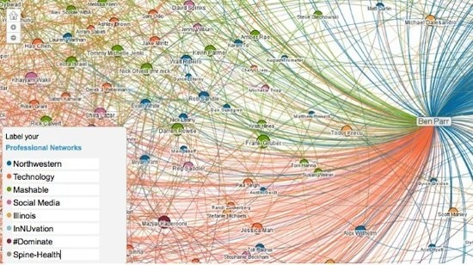
Example of Graph
Social network

Slide 3
Graphs (1)
A graph G = (V, E) consists of a set of vertices V, and a set of edges E, such that each edge in E is a connection between a pair of vertices in V.
The number of vertices is written |V|, and the number edges is written |E|.

Slide 4
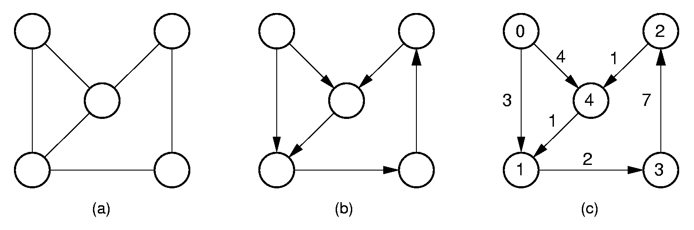
Graphs (2)
undirected graph directed graph labeled graph
weighted graph

Slide 5
Graph Applications
Modeling connectivity in computer networks
Representing maps
Modeling flow capacities in transportation networks
Modeling transitions in algorithms
Ordering tasks
Modeling relationships (families, organizations)

Slide 6
Paths and Cycles
Path: A sequence of vertices v₁, v₂, …, v_{n} of length n-1 with an edge from v_{i} to v_{i+1} for 1 ≤ i < n.
A path is simple if all vertices on the path are distinct.
A cycle is a path of length 3 or more that connects v₁ to itself.
A cycle is simple if all vertices on the path are distinct except the first and last vertices.

Slide 7
Exercises
Write down some paths. Are they simple paths?
Are there any circles in the directed graph? Are they simple circles?
Examples:
ACEDB
ACDBA
CDBACD
A
C
E
B
D

Slide 8
Graphs
Graph Definition
Graph Implementations
Graph Traversals
Shortest-paths Problems
Minimum-Cost Spanning Trees

Slide 9
Subgraph
A subgraph S is formed from graph G by selecting a subset V_{s} of G’s vertices and a subset E_{s} of G’s edges such that for every E in E_{s}, both of whose vertices are in V_{s.}
G=(V,E)
G'=(Vs,Es)
Vs ⸦ V
Es ⸦ E

Slide 10
DAG
A graph without cycles is called acyclic.
A directed graph without cycles is called a directed acyclic graph of DAG.
Question:
Which application is DAG suitable for ??

Slide 11
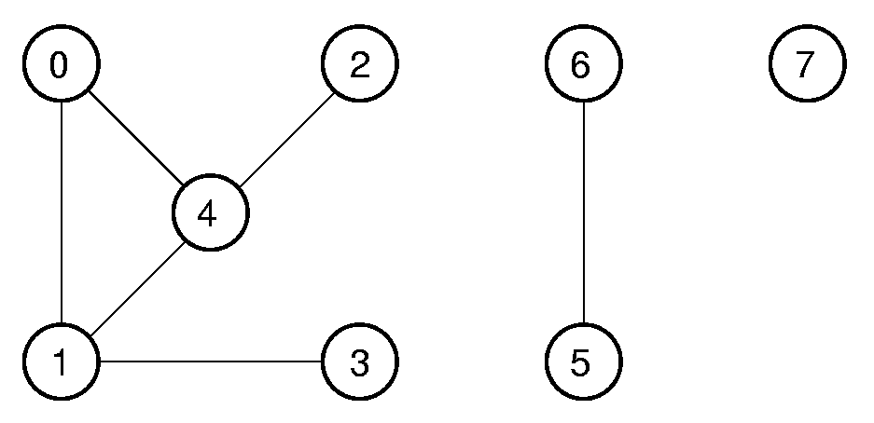
Connected Components
An undirected graph is connected (连通图）if there is at least one path from any vertex to any other.
The maximum connected subgraphs of an undirected graph are called connected components(连通分量）.
3 connected components
contained in the graph

Slide 12
Connected Components
An directed graph is strongly connected if there is at least one path from any vertex to any other.
An directed graph is weakly connected if there is at least one unidirectional path between any vertex to any other.
A
C
A
C
E
E
B
D
B
D
strongly connected weakly connected

Slide 13
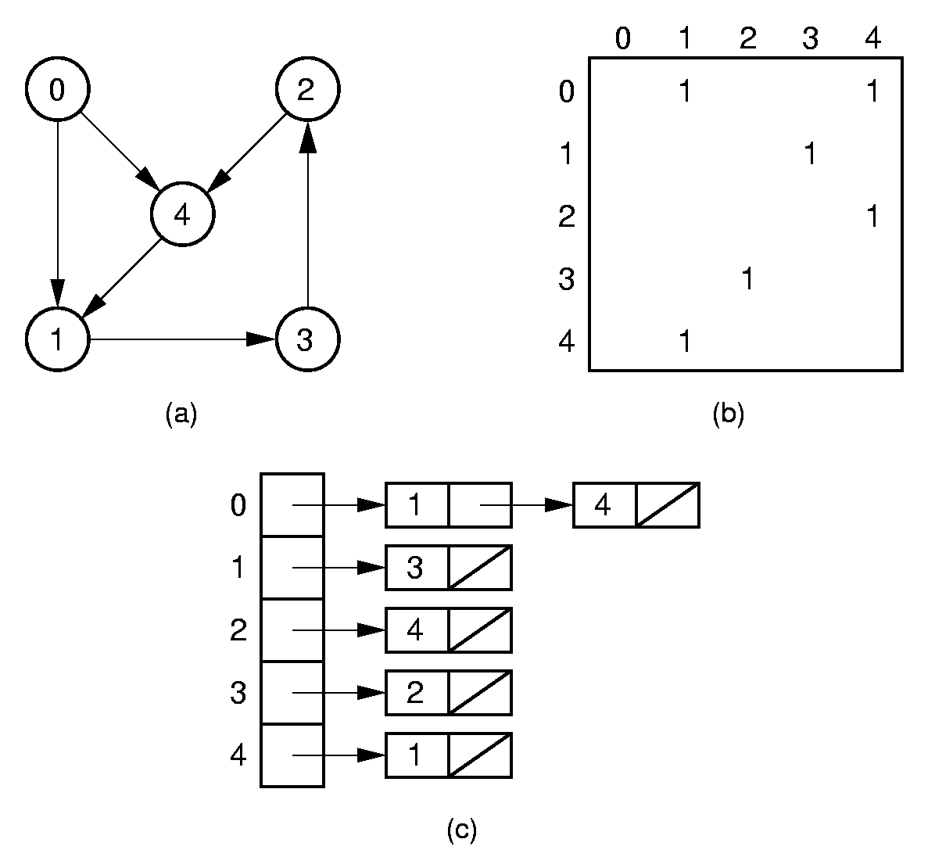
Directed Representation
Adjacency matrix
Outdegree
Indegree
adjacent
neighbor
Adjacency list

Slide 14
Directed Representation
Adjacency matrix
Is it easy for finding neighbors?
Is it easy to get the outdegree and indegree?
Adjacency list

Slide 15
Directed Representation
Adjacency matrix
Inverse Adjacency list
Exercise: give the Inverse Adjacency list
for this graph
Adjacency list

Slide 16
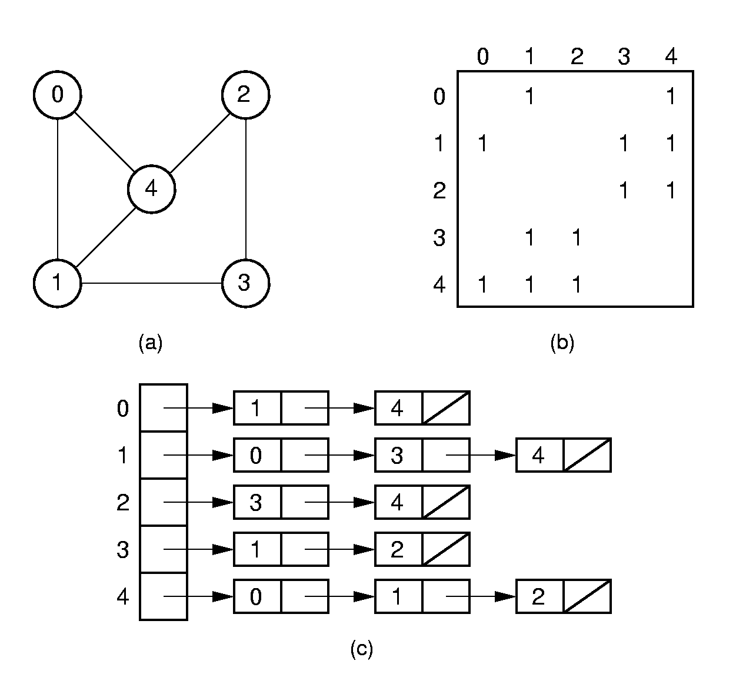
Undirected Representation
Adjacency matrix
Adjacency list

Slide 17
Representation Costs
Adjacency Matrix:
Θ(|V|²) space
Adjacency List:
Θ(|V| + |E|) space
Notes:
Adjacency matrix requires Θ(|V|²) space.
Adjacency list requires Θ(|V| + |E|) space.
|E| could be as low as 0, or as high as Θ(|V|²).
Which representation actually requires less space depends on the number of edges.

Slide 18
Graph ADT
class Graph { // Graph abstract class
public:
virtual int n() =0; // # of vertices
virtual int e() =0; // # of edges
// Return index of first, next neighbor
virtual int first(int) =0;
virtual int next(int, int) =0;
// Store new edge
virtual void setEdge(int, int, int) =0;
// Delete edge defined by two vertices
virtual void delEdge(int, int) =0;
// Weight of edge connecting two vertices
virtual int weight(int, int) =0;
virtual int getMark(int) =0;
virtual void setMark(int, int) =0;
};
Why???

Slide 19
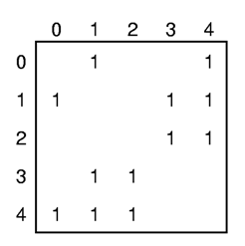
Adjacency Matrix Implementation (1)
class Graphm : public Graph { // Implement adjacency matrix
private:
int numVertex, numEdge; // Store number of vertices, edges
int **matrix; // Pointer to adjacency matrix
int *mark; // Pointer to mark array
public:
Graphm(int numVert) {// Make graph with numVert vertices
int i, j;
numVertex = numVert;
numEdge = 0;
mark = new int[numVert]; // Initialize mark array
for (i=0; i<numVertex; i++)
mark[i] = UNVISITED; // VISTED = 1, UNVISITED = 0
matrix = new int*[numVertex]; // Make matrix
for (i=0; i<numVertex; i++)
matrix[i] = new int[numVertex];
for (i=0; i< numVertex; i++)
for (int j=0; j<numVertex; j++) matrix[i][j] = 0;
}
matrix

Slide 20
Adjacency Matrix Implementation (2)
matrix
int first(int v) { // Return v's first neighbor
int i;
for (i=0; i<numVertex; i++)
if (matrix[v][i] != 0) return i;
return i; // Return numVertex if none
}
int next(int v1, int v2) { // Get v1's neighbor after v2
int i;
for(i=v2+1; i<numVertex; i++)
if (matrix[v1][i] != 0) return i;
return i; // Return numVertex if none
}

Slide 21
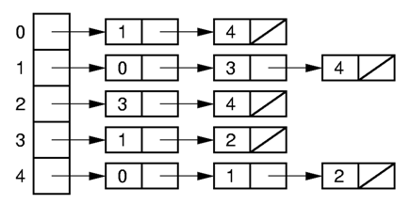
Adjacency List Implementation (1)
vertex
class Edge {
public:
int vertex, weight;
Edge() { vertex = -1; weight = -1; }
Edge(int v, int w) { vertex = v; weight = w; }
};
class Graphl : public Graph { // Implement adjacency list
private:
int numVertex, numEdge; // Number of vertices, edges
List<Edge>** vertex; // List headers
int *mark; // Pointer to mark array

Slide 22
Adjacency List Implementation (2)
vertex
Graphl(int numVert) { // Make graph with numVert vertices
int i, j;
numVertex = numVert; numEdge = 0;
mark = new int[numVert]; // Initialize mark array
for (i=0; i<numVertex; i++) mark[i] = UNVISITED;
// Create and initialize adjacency lists
vertex = new List<Edge>*[numVertex];
for (i=0; i<numVertex; i++)
vertex[i] = new LList<Edge>();
}

Slide 23
Adjacency List Implementation (3)
vertex
int first(int v) { // Return first neighbor of v
Edge it;
vertex[v]->setStart();
if (vertex[v]->getValue(it)) return it.vertex;
else return numVertex; // Return n if none
}
int next(int v1, int v2) { // Gete v1's neighbor after v2
Edge it;
vertex[v1]->getValue(it);
if (it.vertex == v2) vertex[v1]->next();
else { // Start from beginning of list
vertex[v1]->setStart();
while (vertex[v1]->getValue(it) && (it.vertex <= v2))
vertex[v1]->next();
}
if (vertex[v1]->getValue(it)) return it.vertex;
else return numVertex; // Return n if none
}

Slide 24
Graphs
Graph Definition
Graph Implementations
Graph Traversals
Shortest-paths Problems
Minimum-Cost Spanning Trees

Slide 25
Graph Traversals (1)
Some applications require visiting every vertex in the graph exactly once.
The application may require that vertices be visited in some special order based on graph topology.

Slide 26
Graph Traversals (2)
To insure visiting all vertices:
void graphTraverse(const Graph* G) {
for (v=0; v<G->n(); v++)
G->setMark(v, UNVISITED); // Initialize
for (v=0; v<G->n(); v++)
if (G->getMark(v) == UNVISITED)
doTraverse(G, v);
}
Notes:
doTraverse might be implemented by any of the graph traversals that we are about to discuss.

Slide 27
Graphs
Graph Definition
Graph Implementations
Graph Traversals
Depth First search (DFS)
Breadth First Search (BFS)
Topological Sort ( directed graph)
Shortest-paths Problems
Minimum-Cost Spanning Trees

Slide 28
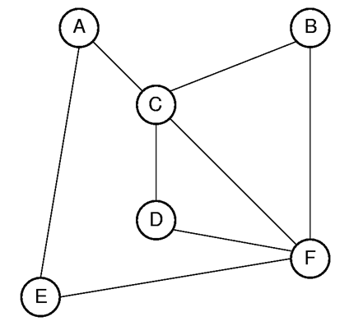
Depth First Search (DFS)
Order that nodes are processed: ACBFDE
Go as deep as possible!
Notes:
Order that nodes are processed: ACBFDE

Slide 29
Depth First Search Tree (DFS Tree)
The DFS tree for the graph when starting at vertex A
Notes:
Order that nodes are processed: ACBFDE

Slide 30
Depth First Search (DFS) (2)
// Depth first search
void DFS(Graph* G, int v) {
PreVisit(G, v); // Take action
G->setMark(v, VISITED);
for (int w=G->first(v); w<G->n();
w = G->next(v,w))
if (G->getMark(w) == UNVISITED)
DFS(G, w);
PostVisit(G, v); // Take action
}
DFS(G, A)
DFS(G, C)
DFS(G,B)
DFS(G,F)
ACBFDE
DFS(G,D)
DFS(G,E)
Notes:
Why this procedure can make the visiting go deeper and deeper

Slide 31
Graphs
Graph Definition
Graph Implementations
Graph Traversals
Depth First search (DFS)
Breadth First Search (BFS)
Topological Sort ( directed graph)
Shortest-paths Problems
Minimum-Cost Spanning Trees

Slide 32
Breadth First Search (BFS) (1)
Order that nodes are processed: ACEBDF
Visit A -> Visit A’s neighbors -> vist A’s neighbors’ neighbors…
Notes:
Order that nodes are processed: ACBFDE

Slide 33
Breadth First Search (BFS) (2)
A
C
E
Queue to serialize the visit sequence
Visit A -> Visit A’s neighbors -> vist A’s neighbors’ neighbors…
Order that nodes are processed: ACEBDF
Notes:
Why the queue can make the procedure as breadth first

Slide 34
Breadth First Search (BFS) (2)
C
E
B
D
F
Queue to serialize the visit sequence
Visit A -> Visit A’s neighbors -> vist A’s neighbors’ neighbors…
Order that nodes are processed: ACEBDF
Notes:
Order that nodes are processed: ACBFDE

Slide 35
Breadth First Search (BFS) (2)
E
B
D
F
Queue to serialize the visit sequence
Visit A -> Visit A’s neighbors -> vist A’s neighbors’ neighbors…
Order that nodes are processed: ACEBDF
Notes:
Order that nodes are processed: ACBFDE

Slide 36
Breadth First Search (BFS) (2)
B
D
F
Queue to serialize the visit sequence
Visit A -> Visit A’s neighbors -> vist A’s neighbors’ neighbors…
Order that nodes are processed: ACEBDF
Notes:
Order that nodes are processed: ACBFDE

Slide 37
Breadth First Search (BFS) (2)
D
F
Queue to serialize the visit sequence
Visit A -> Visit A’s neighbors -> vist A’s neighbors’ neighbors…
Order that nodes are processed: ACEBDF
Notes:
Order that nodes are processed: ACBFDE

Slide 38
Breadth First Search (BFS) (2)
F
Queue to serialize the visit sequence
Visit A -> Visit A’s neighbors -> vist A’s neighbors’ neighbors…
Order that nodes are processed: ACEBDF
Notes:
Order that nodes are processed: ACBFDE

Slide 39
Breadth First Search (BFS) (3)
void BFS(Graph* G, int start,Queue<int>*Q) {
int v, w;
Q->enqueue(start); // Initialize Q
G->setMark(start, VISITED);
while (Q->length() != 0) { // Process Q
Q->dequeue(v);
PreVisit(G, v); // Take action
for(w=G->first(v);w<G->n();w=G->next(v,w))
if (G->getMark(w) == UNVISITED) {
G->setMark(w, VISITED);
Q->enqueue(w);
}
PostVisit(G,v);
}
}
Notes:
Order that nodes are processed: ACBFDE

Slide 40
Breadth First Search Tree (BFS Tree)
The BFS tree for the graph when starting at vertex A
Notes:
Order that nodes are processed: ACBFDE

Slide 41
DFS和BFS的应用
DFS：
Maze problem
Find the path. For example, is there a path from A to B?
Find connected components
Determination of cycles
Bipartite graphs
Topological sort
BFS：
The shortest path, such as calculating the number of network hops
Distance between vertices
Notes:
Order that nodes are processed: ACBFDE

Slide 42
Graphs
Graph Definition
Graph Implementations
Graph Traversals
Depth First search (DFS)
Breadth First Search (BFS)
Topological Sort ( directed graph)
Shortest-paths Problems
Minimum-Cost Spanning Trees

Slide 43
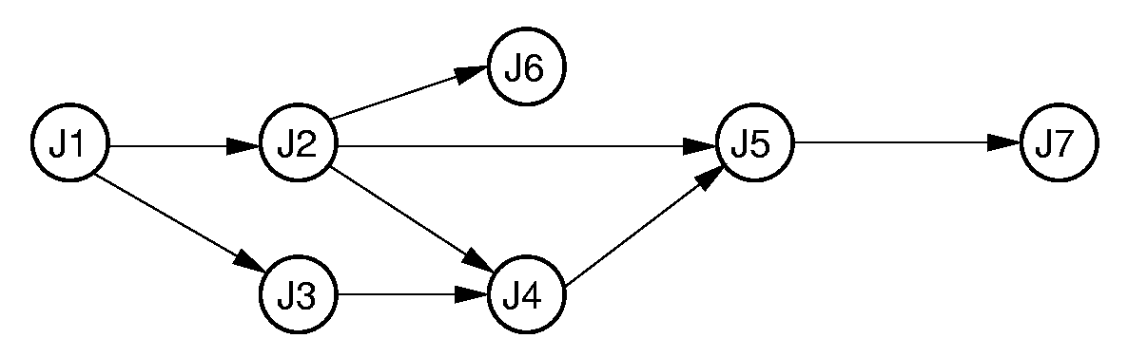
Topological Sort (1)
Problem: Given a set of jobs, courses, etc., with prerequisite (先决条件 /’pri:’rekwizit/ ) constraints, output the jobs in an order that does not violate any of the prerequisites.
J1,J3,J2,J6,J4,J5,J7

Slide 44
Example
课程编号 课程名称 先决条件
C₁ 程序设计基础 无
C₂ 离散数学 C₁
C₃ 数据结构 C₁，C₂
C₄ 汇编语言 C₁
C₅ 语言的设计和分析 C₃，C₄
C₆ 计算机原理 C₁₁
C₇ 编译原理 C₃，C₅
C₈ 操作系统 C₃，C₆
C₉ 高等数学 无
C₁₀ 线性代数 C₉
C₁₁ 普通物理 C₉
C₁₂ 数值分析 C₉，C₁₀，C₁
图7.18 软件专业的学生必须学习的课程

Slide 45
C₄
C₅
C₂
C₁
C₃
C₇
C₁₂
C₈
C₉
C₁₀
C₆
C₁₁
Topological Sort Result:
1．(C₁, C₂, C₃, C₄, C₅, C₇, C₉, C₁₀, C₁₁, C₆, C₁₂, C₈)
2．(C₉, C₁₀, C₁₁, C₆, C₁, C₁₂, C₄, C₂, C₃, C₅, C₇, C₈)
More？
Who can be output first ?

Slide 46
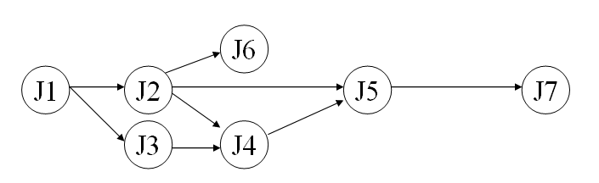
Topological Sort (1)
J6
J1
J2
J5
J7
J3
J4
J1
J2
J3
J4
J6
J5
J7
Output the node with 0 indegree
(the count of edges pointing to the node)
Notes:
Prints in reverse order.

Slide 47
Queue-Based Topsort
void topsort(Graph* G, Queue<int>* Q) {
int Count[G->n()]; //indegree array
int v, w;
for (v=0; v<G->n(); v++) Count[v] = 0;
for (v=0; v<G->n(); v++) // Process edges
for (w=G->first(v); w<G->n();
w = G->next(v,w))
Count[w]++; // Add to v2's count
for (v=0; v<G->n(); v++) // Initialize Q
if (Count[v] == 0) // No prerequisites
Q->enqueue(v);
while (Q->length() != 0) {
Q->dequeue(v);
printout(v); // PreVisit for V
for (w=G->first(v); w<G->n();
w = G->next(v,w)) {
Count[w]--; // One less prereq
if (Count[w] == 0) // Now free
Q->enqueue(w);
}}}
Notes:
Prints in reverse order.

Slide 48
Graphs
Graph Definition
Graph Implementations
Graph Traversals
Depth First search
Breadth First Search
Topological Sort ( directed graph)
Shortest-paths Problems
Minimum-Cost Spanning Trees

Slide 49
Shortest Paths Problems
Input: A graph with weights or costs associated with each edge.
Output: The list of edges forming the shortest path.
Sample problems:
Find shortest path between two specified vertices
Find shortest path from S to all other vertices
Find shortest path between all pairs of vertices

Slide 50
Shortest Paths Definitions
d(A, B) is the shortest distance from vertex A to B.
w(A, B) is the weight of the edge connecting A to B.
If there is no such edge, then w(A, B) = ∞.
Notes:
w(A, D) = 20; d(A, D) = 10 (through ABCD).

Slide 51
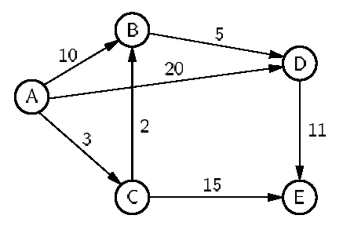
Shortest Paths Example
w(A, D) = 20;
d(A, D) =
10 (through ACBD).

Slide 52
Graphs
Graph Definition
Graph Implementations
Graph Traversals
Depth First search
Breadth First Search
Topological Sort ( directed graph)
Shortest-paths Problems
Single source shortest path
All pairs shortest path
Minimum-Cost Spanning Trees

Slide 53
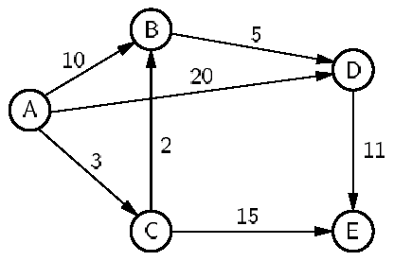
Single-Source Shortest Paths
Given start vertex A, find the shortest path from A to all other vertices.
Compute the shortest path according to the following order:
Find the node closest to A
Find the second closest node
Find the third closest node
… …
The node A is the start vertex.
Notes:
This solution is known as Dijkstra’s algorithm

Slide 54
Single-Source Shortest Paths
Given start vertex A, find the shortest path from A to all other vertices.
(1) At the beginning, We only know the length of the shortest path from A to A is the 0.
The array to record the distance estimate from A
 | A | B | C | D | E
Initial | 0 | ∞ | ∞ | ∞ | ∞
The node A is the start vertex.
Notes:
This solution is known as Dijkstra’s algorithm

Slide 55
Single-Source Shortest Paths
(2) Find the vertex closest to A.
 | A | B | C | D | E
Initial | 0 | ∞ | ∞ | ∞ | ∞
Process A | 0 | 10 | 3 | 20 | ∞
The node A is the start vertex.
C is closest to A
d(A, C) = 3.
Notes:
This solution is known as Dijkstra’s algorithm

Slide 56
Single-Source Shortest Paths
(3) Find the second closest vertex.
 | A | B | C | D | E
Initial | 0 | ∞ | ∞ | ∞ | ∞
Process A | 0 | 10 | 3 | 20 | ∞
Process C | 0 | 5 | 3 | 20 | 18
The node A is the start vertex.
B is the second closest vertex.
d (A, B) = 3.
Notes:
This solution is known as Dijkstra’s algorithm

Slide 57
Single-Source Shortest Paths
(4) Find the third closest vertex.
 | A | B | C | D | E
Initial | 0 | ∞ | ∞ | ∞ | ∞
Process A | 0 | 10 | 3 | 20 | ∞
Process C | 0 | 5 | 3 | 20 | 18
Process B | 0 | 5 | 3 | 10 | 18
The node A is the start vertex.
D is the third closest vertex.
d(A, D) = 10.
Notes:
This solution is known as Dijkstra’s algorithm

Slide 58
Single-Source Shortest Paths
(5) Find the fourth closest vertex.
 | A | B | C | D | E
Initial | 0 | ∞ | ∞ | ∞ | ∞
Process A | 0 | 10 | 3 | 20 | ∞
Process C | 0 | 5 | 3 | 20 | 18
Process B | 0 | 5 | 3 | 10 | 18
Process D | 0 | 5 | 3 | 10 | 18
The node A is the start vertex.
E is the fourth closest vertex.
d(A, E) = 18
Notes:
This solution is known as Dijkstra’s algorithm

Slide 59
Dijkstra’s Implementation (1)
// Compute shortest path distances from s,
// return them in D
void Dijkstra(Graph* G, int* D, int s) {
}
The array D to record the distance estimate from A
 | A | B | C | D | E
Initial | 0 | ∞ | ∞ | ∞ | ∞
s -> A

Slide 60
Dijkstra’s Implementation (2)
for (i=0; i<G->n(); i++){
v = minVertex(G, D);
if (D[v] == INFINITY) return;
G->setMark(v, VISITED);
for (w=G->first(v);
w<G->n(); w = G->next(v,w))
{
if (D[w] >(D[v] + G->weight(v, w)))
D[w] = D[v]+ G->weight(v, w);
}
}
 | A | B | C | D | E
Initial | 0 | ∞ | ∞ | ∞ | ∞
Process A 0 ∞ ∞ ∞ ∞
10
3
20
w-> C
w-> B
v -> A
w-> D

Slide 61
Dijkstra’s Implementation (2)
for (i=0; i<G->n(); i++){
v = minVertex(G, D);
if (D[v] == INFINITY) return;
G->setMark(v, VISITED);
for (w=G->first(v);
w<G->n(); w = G->next(v,w))
{
if (D[w] >(D[v] + G->weight(v, w)))
D[w] = D[v]+ G->weight(v, w);
}
}
 | A | B | C | D | E
Initial | 0 | ∞ | ∞ | ∞ | ∞
Process A 0 10 3 20 ∞
18
Process C 0 ∞ 3 20 ∞
5
w-> B
v -> C
w-> E

Slide 62
Dijkstra’s Implementation (2)
for (i=0; i<G->n(); i++){
v = minVertex(G, D);
if (D[v] == INFINITY) return;
G->setMark(v, VISITED);
for (w=G->first(v);
w<G->n(); w = G->next(v,w))
{
if (D[w] >(D[v] + G->weight(v, w)))
D[w] = D[v]+ G->weight(v, w);
}
}
 | A | B | C | D | E
Initial | 0 | ∞ | ∞ | ∞ | ∞
Process A 0 ∞ 3 20 ∞
Process C 0 5 3 20 18
Process B 0 5 3 20 18
10
v -> B
w-> D

Slide 63
Dijkstra’s Implementation (2)
for (i=0; i<G->n(); i++){
v = minVertex(G, D);
if (D[v] == INFINITY) return;
G->setMark(v, VISITED);
for (w=G->first(v);
w<G->n(); w = G->next(v,w))
{
if (D[w] >(D[v] + G->weight(v, w)))
D[w] = D[v]+ G->weight(v, w);
}
}
 | A | B | C | D | E
Initial | 0 | ∞ | ∞ | ∞ | ∞
Process A 0 ∞ 3 20 ∞
Process C 0 5 3 20 18
Process B 0 5 3 10 18
v -> D
w-> E
Process D 0 5 3 10 18

Slide 64
Dijkstra’s Implementation (2)
for (i=0; i<G->n(); i++){
v = minVertex(G, D);
if (D[v] == INFINITY) return;
G->setMark(v, VISITED);
for (w=G->first(v);
w<G->n(); w = G->next(v,w))
{
if (D[w] >(D[v] + G->weight(v, w)))
D[w] = D[v]+ G->weight(v, w);
}
}
 | A | B | C | D | E
Initial | 0 | ∞ | ∞ | ∞ | ∞
Process A 0 ∞ 3 20 ∞
Process C 0 5 3 20 18
Process B 0 5 3 10 18
v -> E
Process D 0 5 3 10 18

Slide 65
Dijkstra’s Implementation (3)
// Compute shortest path distances from s,
// return them in D
void Dijkstra(Graph* G, int* D, int s) {
int i, v, w;
for (i=0; i<G->n(); i++) { // Do vertices
v = minVertex(G, D);
if (D[v] == INFINITY) return;
G->setMark(v, VISITED);
for (w=G->first(v); w<G->n();
w = G->next(v,w))
if (D[w] > (D[v] + G->weight(v, w)))
D[w] = D[v] + G->weight(v, w);
}
}

Slide 66
Implementing minVertex
minVertex(Graph* G, int* D)
-- Find the unvisited vertex i with minimum D[i].
Approach 1: Scan through the table D of current distances.

Slide 67
Approach 1
// Find min cost vertex
int minVertex(Graph* G, int* D) {
int i, v;
// Set v to an unvisited vertex
for (i=0; i<G->n(); i++)
if (G->getMark(i) == UNVISITED)
{ v = i; break; }
// Now find smallest D value
for (i++; i<G->n(); i++)
if ((G->getMark(i) == UNVISITED) &&
(D[i] < D[v]))
v = i;
return v;
}
Cost of minVertex: Θ(|V|).

Slide 68
Total cost
// Compute shortest path distances from s,
// return them in D
void Dijkstra(Graph* G, int* D, int s) {
int i, v, w;
for (i=0; i<G->n(); i++) { // Do vertices
v = minVertex(G, D);
if (D[v] == INFINITY) return;
G->setMark(v, VISITED);
for (w=G->first(v); w<G->n();
w = G->next(v,w))
if (D[w] > (D[v] + G->weight(v, w)))
D[w] = D[v] + G->weight(v, w);
}
}
Θ(|V|²).
Θ(|E|)
Cost of minVertex: Θ(|V|).
Total cost of Dijkstra algorithm: Θ(|V|² + |E|) = Θ(|V|²).

Slide 69
Approach 2
minVertex(Graph* G, int* D)
-- Find the unvisited vertex i with minimum D[i].
Approach 2: Store unprocessed vertices using a min-heap to implement a priority queue ordered by D value.

Slide 70
 | A | B | C | D | E
Initial | 0 | ∞ | ∞ | ∞ | ∞
0
A
Notes:
This solution is known as Dijkstra’s algorithm

Slide 71
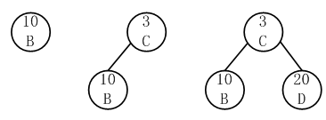
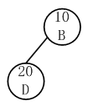
 | A | B | C | D | E
Initial | 0 | ∞ | ∞ | ∞ | ∞
Process A | 0 | 10 | 3 | 20 | ∞
Notes:
This solution is known as Dijkstra’s algorithm

Slide 72
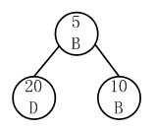
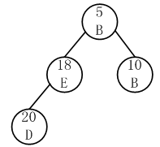
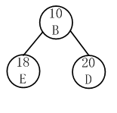
 | A | B | C | D | E
Initial | 0 | ∞ | ∞ | ∞ | ∞
Process A | 0 | 10 | 3 | 20 | ∞
Process C | 0 | 5 | 3 | 20 | 18
Notes:
This solution is known as Dijkstra’s algorithm

Slide 73
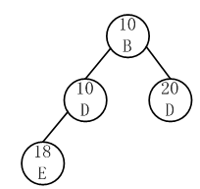
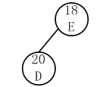
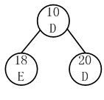
 | A | B | C | D | E
Initial | 0 | ∞ | ∞ | ∞ | ∞
Process A | 0 | 10 | 3 | 20 | ∞
Process C | 0 | 5 | 3 | 20 | 18
Process B | 0 | 5 | 3 | 10 | 18
Notes:
This solution is known as Dijkstra’s algorithm

Slide 74

 | A | B | C | D | E
Initial | 0 | ∞ | ∞ | ∞ | ∞
Process A | 0 | 10 | 3 | 20 | ∞
Process C | 0 | 5 | 3 | 20 | 18
Process B | 0 | 5 | 3 | 10 | 18
Process D | 0 | 5 | 3 | 10 | 18
Notes:
This solution is known as Dijkstra’s algorithm

Slide 75
Heap node definition
class DijkElem {
public:
int vertex, distance;
DijkElem() { vertex = -1; distance = -1; }
DijkElem(int v, int d) { vertex = v; distance = d; }
};
0
A

Slide 76
Approach 2
void Dijkstra(Graph* G, int* D, int s) {
int i, v, w; // v is current vertex
DijkElem temp;
DijkElem E[G->e()]; // Heap array
temp.distance = 0; temp.vertex = s;
E[0] = temp; // Initialize heap array
minheap<DijkElem, DDComp> H(E, 1, G->e());
for (i=0; i<G->n(); i++) {// Get distances
do { if(!H.removemin(temp)) return;
v = temp.vertex;
} while (G->getMark(v) == VISITED);
G->setMark(v, VISITED);
if (D[v] == INFINITY) return;
for(w=G->first(v); w<G->n(); w=G->next(v,w))
if (D[w] > (D[v] + G->weight(v, w))) {
D[w] = D[v] + G->weight(v, w);
temp.distance = D[w]; temp.vertex = w;
H.insert(temp); // Insert in heap
}}}
Θ(log|E|)
Θ(log|E|)
Total Cost: Θ((|V| + |E|)log|E|) (When |E| >= |V|)

Slide 77
Comparison of Implementations
Approach 1
Total Cost: Θ(|V|²).
Dense graph ( |E| approaches |V|² )
Approach 2
Total Cost: Θ((|V| + |E|)log|E|)
Dense graph ( |E| approaches |V|² )
Θ( |V|² log|V| )
Sparse graph ( |E| approaches |V| )
Θ( |V| log|V| )
(When |E| >= |V|)

Slide 78
Graphs
Graph Definition
Graph Implementations
Graph Traversals
Depth First search
Breadth First Search
Topological Sort ( directed graph)
Shortest-paths Problems
Single source shortest path
All pairs shortest path
Minimum-Cost Spanning Trees

Slide 79
All-Pairs Shortest Paths (1)
For every vertex u, v ∈ V, calculate d(u, v).
Solution: Run Dijkstra’s Algorithm |V| times.
Approach 1
Total Cost: Θ((|V|² + |E|)|V| ) = Θ(|V|³).
Approach 2
Total Cost: Θ(((|V| + |E|)log|E|) |V| )
Sparse graph Θ( |V|² log|V| )
Dense graph Θ( |V|³ log|V| )
Notes:
Floyd’s algorithm is an example of dynamic programming. The issue is how to efficiently check all the paths without computing any path more than once.
1, 3 is a 0-path, since no vertices intervene. 2, 0, 3 is a 1-path since the highest-valued vertex (aside from the endpoints) is 0. 0, 2, 3 is a 3-path, but not a 2- or 1-path. All paths are 4-paths.

Slide 80
All-Pairs Shortest Paths (2)
Another simpler solution: Floyd’s Algorithm.
Define a k-path from u to v to be any path whose intermediate vertices all have indices less than k.
Notes:
Floyd’s algorithm is an example of dynamic programming. The issue is how to efficiently check all the paths without computing any path more than once.
1, 3 is a 0-path, since no vertices intervene. 2, 0, 3 is a 1-path since the highest-valued vertex (aside from the endpoints) is 0. 0, 2, 3 is a 3-path, but not a 2- or 1-path. All paths are 4-paths.

Slide 81
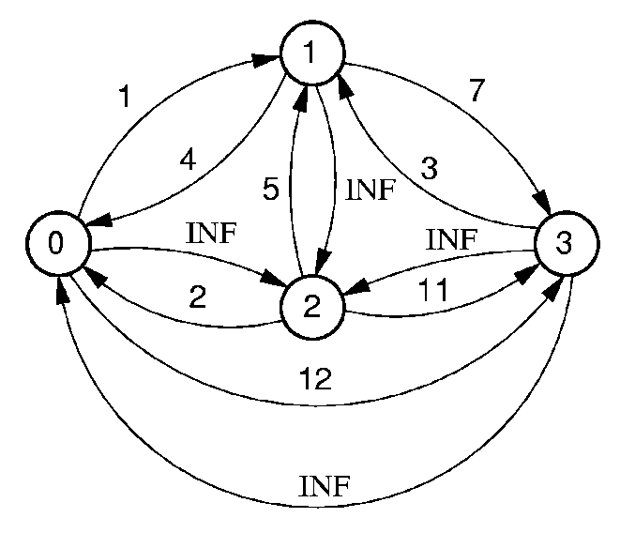
K-path
0,3 is a 0-path.
2,0,3 is a 1-path.
0,2,3 is a 3-path, but not a 2 or 1 path. Every path is a 4-path.
Define D_{K}(v, u) : the length of the shortest k-path from v to u.
D₀(v, u) >= D₁(v, u) >= D₂(v, u) >= … >= D_{n}(v, u) = d(v, u)

Slide 82
Floyd’s Algorithm (1)
D₀(v, u)
0 1 2 3 4 5
 | 1 | 2 | 3 | 4 | 5 | 6
1 | 0 | 10 | ∞ | 20 | ∞ | 2
2 | 10 | 0 | 3 | 5 | ∞ | ∞
3 | ∞ | 3 | 0 | ∞ | 15 | ∞
4 | 20 | 5 | ∞ | 0 | 11 | 10
5 | ∞ | ∞ | 15 | 11 | 0 | 3
6 | 2 | ∞ | ∞ | 10 | 3 | 0
0
1
2
3
4
5
D₀(v, u) is corresponding to the direct connection.
D₁(v, u) ? D₂(v, u)? …

Slide 83
Floyd’s Algorithm (2)
Given D_{k}(v,u), how to get D_{k+1}(v,u)
Assume v, ….,u is a k+1-path.
If the vertex k is not in the path, the path is also a k-path and the shortest length is D_{k}(v, u) in this case.
If the vertex k is in the path. The path can be separate into 2 paths: v,…..,k and k,…,u. Both of them are k-path. Thus the shortest length is D_{k}(v, k) + D_{k}(k, u).
Consider the 2 cases above, the shortest length of the k+1-path is:
D_{k+1}(v, u) = min{D_{k}(v, u), D_{k}(v, k) + D_{k}(k, u)}

Slide 84
D₀(v, u)
D₁(v, u)
0 1 2 3 4 5
0 1 2 3 4 5
 | 1 | 2 | 3 | 4 | 5 | 6
1 | 0 | 10 | ∞ | 20 | ∞ | 2
2 | 10 | 0 | 3 | 5 | ∞ | ∞
3 | ∞ | 3 | 0 | ∞ | 15 | ∞
4 | 20 | 5 | ∞ | 0 | 11 | 10
5 | ∞ | ∞ | 15 | 11 | 0 | 3
6 | 2 | ∞ | ∞ | 10 | 3 | 0
 | 1 | 2 | 3 | 4 | 5 | 6
1 | 0 | 10 | ∞ | 20 | ∞ | 2
2 | 10 | 0 | 3 | 5 | ∞ | 12
3 | ∞ | 3 | 0 | ∞ | 15 | ∞
4 | 20 | 5 | ∞ | 0 | 11 | 10
5 | ∞ | ∞ | 15 | 11 | 0 | 3
6 | 2 | 12 | ∞ | 10 | 3 | 0
0
1
2
3
4
5
0
1
2
3
4
5
D_{k+1}(v, u) = min{D_{k}(v, u), D_{k}(v, k) + D_{k}(k, u)}

Slide 85
D₁(v, u)
D₂(v, u)
0 1 2 3 4 5
0 1 2 3 4 5
 | 1 | 2 | 3 | 4 | 5 | 6
1 | 0 | 10 | ∞ | 20 | ∞ | 2
2 | 10 | 0 | 3 | 5 | ∞ | 12
3 | ∞ | 3 | 0 | ∞ | 15 | ∞
4 | 20 | 5 | ∞ | 0 | 11 | 10
5 | ∞ | ∞ | 15 | 11 | 0 | 3
6 | 2 | 12 | ∞ | 10 | 3 | 0
 | 1 | 2 | 3 | 4 | 5 | 6
1 | 0 | 10 | 13 | 15 | ∞ | 2
2 | 10 | 0 | 3 | 5 | ∞ | 12
3 | 13 | 3 | 0 | 8 | 15 | 15
4 | 15 | 5 | 8 | 0 | 11 | 10
5 | ∞ | ∞ | 15 | 11 | 0 | 3
6 | 2 | ∞ | 15 | 10 | 3 | 0
0
1
2
3
4
5
0
1
2
3
4
5
D_{k+1}(v, u) = min{D_{k}(v, u), D_{k}(v, k) + D_{k}(k, u)}

Slide 86
D₂(v, u)
D₃(v, u)
0 1 2 3 4 5
0 1 2 3 4 5
 | 1 | 2 | 3 | 4 | 5 | 6
1 | 0 | 10 | 13 | 15 | ∞ | 2
2 | 10 | 0 | 3 | 5 | ∞ | 12
3 | 13 | 3 | 0 | 8 | 15 | 15
4 | 15 | 5 | 8 | 0 | 11 | 10
5 | ∞ | ∞ | 15 | 11 | 0 | 3
6 | 2 | ∞ | 15 | 10 | 3 | 0
 | 1 | 2 | 3 | 4 | 5 | 6
1 | 0 | 10 | 13 | 15 | ∞ | 2
2 | 10 | 0 | 3 | 5 | 18 | 12
3 | 13 | 3 | 0 | 8 | 15 | 15
4 | 15 | 5 | 8 | 0 | 11 | 10
5 | ∞ | 18 | 15 | 11 | 0 | 3
6 | 2 | ∞ | 15 | 10 | 3 | 0
0
1
2
3
4
5
0
1
2
3
4
5
D_{k+1}(v, u) = min{D_{k}(v, u), D_{k}(v, k) + D_{k}(k, u)}

Slide 87
D₃(v, u)
D₄(v, u)
0 1 2 3 4 5
0 1 2 3 4 5
 | 1 | 2 | 3 | 4 | 5 | 6
1 | 0 | 10 | 13 | 15 | ∞ | 2
2 | 10 | 0 | 3 | 5 | 18 | 12
3 | 13 | 3 | 0 | 8 | 15 | 15
4 | 15 | 5 | 8 | 0 | 11 | 10
5 | ∞ | 18 | 15 | 11 | 0 | 3
6 | 2 | ∞ | 15 | 10 | 3 | 0
 | 1 | 2 | 3 | 4 | 5 | 6
1 | 0 | 10 | 13 | 15 | 26 | 2
2 | 10 | 0 | 3 | 5 | 16 | 12
3 | 13 | 3 | 0 | 8 | 15 | 15
4 | 15 | 5 | 8 | 0 | 11 | 10
5 | 26 | 16 | 15 | 11 | 0 | 3
6 | 2 | ∞ | 15 | 10 | 3 | 0
0
1
2
3
4
5
0
1
2
3
4
5
D_{k+1}(v, u) = min{D_{k}(v, u), D_{k}(v, k) + D_{k}(k, u)}

Slide 88
D₄(v, u)
D₅(v, u)
0 1 2 3 4 5
0 1 2 3 4 5
 | 1 | 2 | 3 | 4 | 5 | 6
1 | 0 | 10 | 13 | 15 | 26 | 2
2 | 10 | 0 | 3 | 5 | 16 | 12
3 | 13 | 3 | 0 | 8 | 15 | 15
4 | 15 | 5 | 8 | 0 | 11 | 10
5 | 26 | 16 | 15 | 11 | 0 | 3
6 | 2 | ∞ | 15 | 10 | 3 | 0
 | 1 | 2 | 3 | 4 | 5 | 6
1 | 0 | 10 | 13 | 15 | 26 | 2
2 | 10 | 0 | 3 | 5 | 16 | 12
3 | 13 | 3 | 0 | 8 | 15 | 15
4 | 15 | 5 | 8 | 0 | 11 | 10
5 | 26 | 16 | 15 | 11 | 0 | 3
6 | 2 | ∞ | 15 | 10 | 3 | 0
0
1
2
3
4
5
0
1
2
3
4
5
D_{k+1}(v, u) = min{D_{k}(v, u), D_{k}(v, k) + D_{k}(k, u)}

Slide 89
D₅(v, u)
D₆(v, u)
0 1 2 3 4 5
0 1 2 3 4 5
 | 1 | 2 | 3 | 4 | 5 | 6
1 | 0 | 10 | 13 | 15 | 26 | 2
2 | 10 | 0 | 3 | 5 | 16 | 12
3 | 13 | 3 | 0 | 8 | 15 | 15
4 | 15 | 5 | 8 | 0 | 11 | 10
5 | 26 | 16 | 15 | 11 | 0 | 3
6 | 2 | ∞ | 15 | 10 | 3 | 0
 | 1 | 2 | 3 | 4 | 5 | 6
1 | 0 | 10 | 13 | 12 | 5 | 2
2 | 10 | 0 | 3 | 5 | 16 | 12
3 | 13 | 3 | 0 | 8 | 15 | 15
4 | 12 | 5 | 8 | 0 | 11 | 10
5 | 5 | 16 | 15 | 11 | 0 | 3
6 | 2 | ∞ | 15 | 10 | 3 | 0
0
1
2
3
4
5
0
1
2
3
4
5
D_{k+1}(v, u) = min{D_{k}(v, u), D_{k}(v, k) + D_{k}(k, u)}

Slide 90
Floyd’s Algorithm
Θ(|V|³).
//Floyd's all-pairs shortest paths algorithm
void Floyd(Graph* G) {
int D[G->n()][G->n()]; // Store distances
for (int i=0; i<G->n(); i++) // Initialize
for (int j=0; j<G->n(); j++)
D[i][j] = G->weight(i, j);
// Compute all k paths
for (int k=0; k<G->n(); k++)
for (int i=0; i<G->n(); i++)
for (int j=0; j<G->n(); j++)
if (D[i][j] > (D[i][k] + D[k][j]))
D[i][j] = D[i][k] + D[k][j];
}
D₀(i, j)
D_{k}(i, j)->D_{k+1}(i, j)
D_{k+1}(i, j) = min{D_{k}(i, j), D_{k}(i, k) + D_{k}(k, j)}

Slide 91
Graphs
Graph Definition
Graph Implementations
Graph Traversals
Depth First search
Breadth First Search
Topological Sort ( directed graph)
Shortest-paths Problems
Minimum-Cost Spanning Trees

Slide 92
Minimal Cost Spanning Trees (1)
Minimal Cost Spanning Tree (MST) Problem:
Input: An undirected, connected graph G.
Output: The subgraph of G that
1) has minimum total cost as measured by summing the values of all the edges in the subset
2) keeps the vertices connected.
The subgraph above is a MST of G.

Slide 93
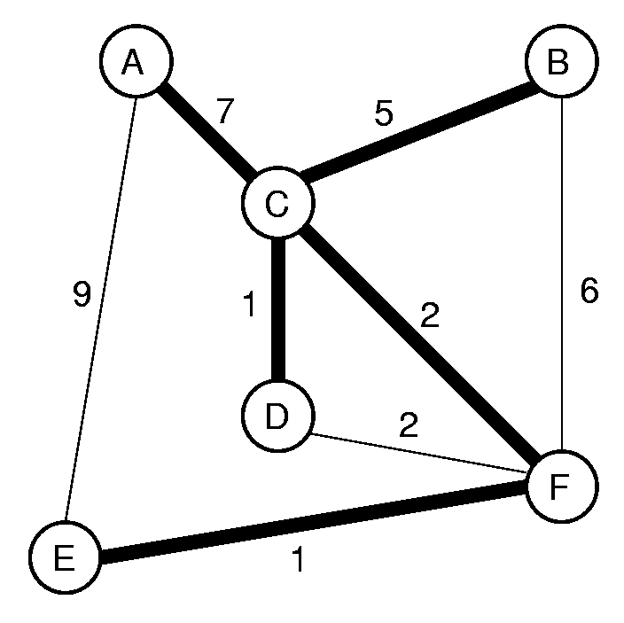
Minimal Cost Spanning Trees (2)
. Prim’s MST Algorithm
. Kruskal’s MST Algorithm

Slide 94
Prim’s MST Algorithm (1)
A
B
7
5
C
9
1
2
6
D
2
F
E
1
Keep the sub-graph connected.
Select the edges with minimum weight.
Notes:
This is an example of a greedy algorithm. Note that its only difference from Dijkstra’s algorithm is in the distance computation. Dijkstra’s algorithm distance is shortest distance from source to vertex in question. Prim’s algorithm distance is shortest distance from any vertex now in the MST to the vertex in question.

Slide 95
D[i] – the minimum distance from the vertex i
to the vertexes in the MST.
 | A | B | C | D | E | F
Initial | ∞ | ∞ | 0 | ∞ | ∞ | ∞
A
B
7
5
C
9
Process C 7 5 0 1 ∞ 2
1
2
6
D
2
Process D 7 5 0 1 ∞ 2
F
Process F 7 5 0 1 1 2
E
1
Process E 7 5 0 1 1 2
Process B 7 5 0 1 1 2
Process A 7 5 0 1 1 2
A | B | C | D | E | F
V[i] – The vetex closest to the vertex i
in the MST.
C
C
C
C
F
C

Slide 96
Prim’s MST Algorithm
void Prim(Graph* G, int* D, int s) {
int V[G->n()]; // Who's closest
int i, w;
for (i=0; i<G->n(); i++) {// Do vertices
int v = minVertex(G, D);
if (D[v] == INFINITY) return;
G->setMark(v, VISITED);
if (v != s) AddEdgetoMST(V[v], v);
for (w=G->first(v); w<G->n();
w = G->next(v,w))
if (D[w] > G->weight(v,w)) {
D[w] = G->weight(v,w);// Update dist
V[w] = v; // Update who it came from
}
}
}
The cost is similar with the Dijstra’s shortest path algorithm
Notes:
This is an example of a greedy algorithm. Note that its only difference from Dijkstra’s algorithm is in the distance computation. Dijkstra’s algorithm distance is shortest distance from source to vertex in question. Prim’s algorithm distance is shortest distance from any vertex now in the MST to the vertex in question.

Slide 97
Kruskal’s MST Algorithm (1)
(1) Initially, each vertex is in its own MST.
(2) Merge two MST’s that have the shortest edge between them.
A
B
7
5
C
9
1
2
6
D
2
F
E
1

Slide 98
Kruskal’s MST Algorithm (2)
How to sort the edges?
Use a priority queue to order the unprocessed edges.
How to tell if an edge connects two vertices already in the same MST?
Use the UNION/FIND algorithm with parent-pointer representation.

Slide 99
Kruskal’s MST Algorithm (3)
Class KruskElem {
public:
int from, to, distance;
KruskElem( ) { from=-1; to=-1; distance=-1; }
KruskElem(int f, int t, int d)
{ from=f; to=t; distance=d; }
};
Kruskal(Graph& G) { // Kruskal's MST algorithm
ParPtrTree A(G->n( )); // Equivalence class array
KruskElem E[G->e( )]; // Array of edges for min-heap
int edgecnt = 0;

Slide 100
Kruskal’s MST Algorithm (4)
for (int i=0; i<G->n( ); i++) // Put edges on array
for (int w = G->first(i); w<G->n( ); w = G->next(i,w)) {
E[edgecnt].distance = G->weight(i,w);
E[edgecnt].from = i; E[edgecnt++].to = w;
}
Minheap<KruskElem,KKComp> H(E, edgecnt, edgecnt);
int numMST = G->n( ); // Init n equiv classes
for (i=0; numMST>1; i++) { // Combine equiv classes
KruskElem temp;
H.removefirst(temp); // Get next cheap edge
int v = temp.from; int u = temp.to;
if (A.differ(v, u)) { // If different equiv classes
A.UNION(v, u); // Combine equiv classes
AddEdgetoMST(v,u); // Add to MST
numMST--; // One less MST
}}}

Slide 101
Kruskal’s MST Algorithm (5)
Cost is dominated by the time to remove edges from the heap.
Total cost:
worst case: Θ(|E| log |E|).
average case: Θ(|V| log |E|).

